Slide 1

Introduction to Human Computer Interaction
Prof. Vishal Chaudhary
Assistant Professor
Department of Information Technology
Hope Foundation’s
International Institute of Information Technology, I²IT
www.isquareit.edu.in

Slide 2
0BHuman Computer Interaction: An Overview
What is Human Computer Interaction (HCI)?
Importance of HCI
Good and Poor Design Examples
What and Who are involved in HCI design?

Slide 3
What is HCI?
The study of bridge between them, which includes
  Observation of interactions between people & computers, e.g., Find examination papers via our library Web
  Analysis of the involved interactions, e.g., Are all the steps involved are necessary?
  Human consequences after interacting with computers, e.g., Can the user perform his task? Does he enjoy working with the computer?

Slide 4
What is HCI?
concerned with the design, evaluation & implementation of interactive computer systems for human use & with the study of major phenomena surrounding them” (1992)
Dix: HCI is study of people, computer technology and these these influence each determine how we can make more usable by people” (1998)
Carroll: HCI is the study and practice of usability. It is about understanding and creating software and other technology that people will want to use, will be able to use, and will find effective when used.” (2002)

Slide 5
Why HCI?
Now, computers are cheap and used by non-technical people (different backgrounds, needs, knowledge, skills)
Computer and software manufacturers have noticed the importance of making computers “user-friendly”: easy to use, save people time, etc.
How to achieve “user-friendliness” in computer design?

Slide 6
HCI Scope
Use & Context: Find application areas for computers
Human : Study psychological & physiological aspects e.g., study how a user learns to use a new product, study human typing speed
Computer: Hardware & software offered e.g., input & output devices, speed, interaction styles, computer graphics
Development: Design, implementation & evaluation

Slide 7
HCI Goals
HCI develop or improve
  Safety
  Utility
  Effectiveness
  Efficiency
  Usability
  Appeal

Slide 8
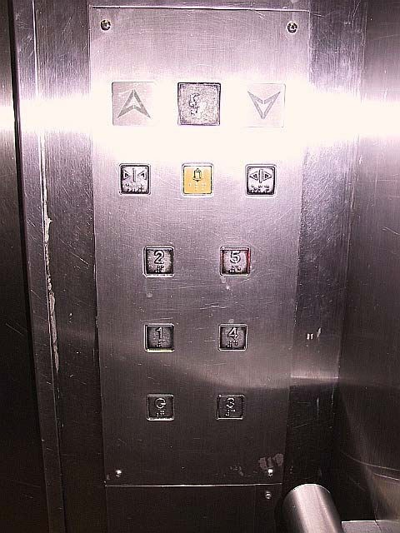
Good and Poor Design Examples
Inside a lift control
Any problems?

Slide 9

Good and Poor Design Examples
This is a lamp switch
There are 3 modes: “I”, “O” and “II” correspond to Low, Off and High, respective
Is it a good design? Why?

Slide 10
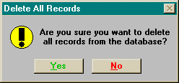
Good and Poor Design Examples
This is an interface of a dialog box
Is it a good design?

Slide 11
THANK YOU
For further details, please contact
Vishal Chaudhary
vishalc@isquareit.edu.in
Department of Information Technology
Hope Foundation’s
International Institute of Information Technology, I²IT
P-14,Rajiv Gandhi Infotech Park
MIDC Phase 1, Hinjawadi, Pune – 411057
Tel - +91 20 22933441/2/3
www.isquareit.edu.in | info@isquareit.edu.in

